Slide 1
Biographies
Karma Tarap
Karma Tarap has over a decade of experience in the pharmaceutical industry and currently serves as an Innovation, Strategy, and Solutions Lead at Bristol-Myers Squibb (BMS).
Specializing in data analytics and clinical programming, he focuses on implementing innovative technologies to enhance pharmaceutical research and development.
Oriana Esposito, PhD
Oriana Esposito, PhD, is a seasoned clinical development expert with over 18 years of pharmaceutical industry experience spanning drug discovery through Phase 3 trials. She currently serves as Senior Director and Hematology Therapeutic Area Lead in Early Clinical Development at Bristol Myers Squibb, where she leads a team of clinical scientists and drives innovation in hematologic malignancies. Oriana holds a BSc (Hons) and PhD in Medicinal Chemistry from the University of Sussex and has previously held roles at Novartis and Chiesi Pharmaceuticals. She is passionate about data analytics, emerging technologies, and mentoring future leaders in clinical research.
Maheshkumar Umbarkar
Mahesh is a skilled R/Shiny developer with over eight years of experience across FinTech, Public Health, and clinical domains. As Senior Manager of Statistical Programming at Bristol Myers Squibb, he leads complex projects and mentors developers, driving innovation through high-quality, data-driven solutions. He holds an MSc in Statistics from North Maharashtra University and is known for his strong analytical skills and commitment to excellence in R development.
Ramnath Balasaheb Dhadage
Ramnath is a Technical Lead in Statistical Programming at Ephicacy with over 8 years of experience building open-source tools for clinical trials. He specializes in R, R Shiny, Quarto, and Python, with expertise in data visualization, package development, and CI/CD pipelines. Ramnath holds a Master’s in Statistics and has received multiple awards for innovation and leadership. A key contributor to projects like the teal framework and blockr, he is passionate about bridging statistical rigor with user-friendly software to drive clinical research forward.
Tamara Martin
Tamara Martin is a Senior Manager of Statistical Programming at Bristol Myers Squibb, where she leads Data Visualization for Early Development and serves as the Project Manager for the implementation of Clinical Data Explorer (CDEx) across both early and late development. Since entering the industry in 2016, she has supported Early Development research, and now focuses on standards, innovation, and vendor-client collaboration. Tamara holds a Bachelor of Science in Mathematics from King University and a Master of Professional Science in Biostatistics from Middle Tennessee State University.
DV394| 1

Slide 2

Clinical Data Explorer (CDEx): Transforming Clinical Data into Actionable Insights
PharmaSUG 2025
DV 394
Notes:
Thanks for being here. I’m Tamara Martin, project manager and statistical programming SME for CDEx. I lead collaboration between programming, clinical, and the CDEx dev team to ensure this tool delivers what teams need. Today I’ll cover what CDEx is, why it matters, how it works, and share what’s coming next. We will also dive into a short demo to introduce you into how the app works and why we are making some enhancements.

Slide 3
Agenda
01 | Objective
02 | CDEx Workflow & Cross-Functional Collaboration
03 | Current Capabilities & Scope
04 | Technical Architecture
05 | Enhancements & Next Steps
06 | Conclusion/Demo
DV394| 3

Slide 4
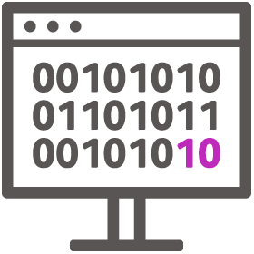
Data Visualization: Objective
"Uncover Data. Drive Decisions.“
Mission: Provide a tool to empower data driven decisions through the life of a clinical trial, to uncover new insights utilizing cutting edge technologies, by generating interactive and static outputs.
CDEx (Insights)
End User: Clinical
Aggregate Interactive Statistical Data Analysis & Visualizations​
Fully in-house data visualization ecosystem developed in partnership with Clinical ​
Dynamic, interactive & consistent user experience ​
Objective
Enhanced and efficient clinical data analytics​
New data visualization capabilities built in-house aligned with BMS needs​
Enhance Clinical Scientist review by reducing time to analyze data and create data presentations for data-driven decisions
Allow for in-stream statistical analysis of ongoing study data providing faster insights​
Use Cases
Benefits
Clinical Data Explorer
(CDEx)
Clinical Data Workbench
(CDW)
TLG
Automation
TLG
Automation
Patient Profiles
4
Notes:
Our mission with CDEx is to provide a tool that empowers data-driven decisions throughout the life of a clinical trial. It leverages cutting-edge technology to deliver both interactive and static outputs that help uncover meaningful insights from clinical data.
But behind every visualization, behind every safety trend or efficacy signal — is a patient. Patients are truly at the heart of everything we do. They're waiting for a breakthrough. They're hoping for a treatment that can give them more time, more options, more hope.
That’s why speed matters. Our clinical stakeholders need the ability to move fast and make informed decisions — to escalate when we see promise, and to stop when we don’t. This ‘go fast, kill fast’ mindset means we need rapid, reliable access to safety and efficacy data.
And that’s where CDEx comes in. It provides a consistent, dynamic, and interactive platform to explore clinical data in near real time — accelerating decisions that ultimately impact patient outcomes.

Slide 5
Agenda
01 | Objective
02 | CDEx Workflow & Cross-Functional Collaboration
03 | Current Capabilities & Scope
04 | Technical Architecture
04 | Enhancements & Next Steps
06 | Demo
DV394| 5

Slide 6




CDEx Workflow
Where does CDEx fit in?
DaVinci Patient Profiles (DV PP)
Clinical Data Explorer (CDEx)
DaVinci TLG Automation
FPFV
End Users: Clinical, DM, Safety, TM, GTM, RCO
Purpose: Clinical and Operational Data Review using Reports and Analytics
Data Source: Raw (CRF+External), ODM, CTMS, Solstice, Watson LIMS, MDR, WHO and MedDRA Dictionaries
Expected Timeframe: Kicked off 3 patients, 3 visits ~2-3 weeks to complete
End Users: Clinical and Medical Writing
Purpose: Patient Level Reports
Data Source: Raw
Refresh Rate: Extracts from Rave in SCE are refreshed daily.
Clinical Data Workbench (CDW)
Expected Timeframe: Kicked off at SDTM Availability ~1.5 weeks to complete
End Users: Clinical
Purpose: Aggregate level reports
Data Source: SDTM
Expected Timeline: Kicked off at ADaM availability ~3 months after FPFV
End Users: Biostatistics and Clinical
Purpose: DPP aligned Tables, Listings, and Graphs
Data Source: ADaM
Notes:
Where does CDEx fit in? CDEx bridges the gap between raw operational data and full statistical output. It’s live shortly after SDTM becomes available—much earlier than ADaM and final TLGs—allowing for rapid insights. The tool ingests SDTM data and ADaM lite structure roughly 6 weeks after FPFV. The standard implementation takes around 8 weeks post-FPFV and includes requirements gathering, kickoff, QC, SME reviews, and UAT training.

Slide 7
CDEx Workflow
Standard CDEx Implementation
Step | Time required | Resources
FPFV |  | Study Programmer to ensure initiation of SDTM Development
SDTM Development | 4-6 weeks post FPFV | SDTM Programmer
Requirements Gathering *Subgrouping & Baseline Characteristics | Scheduled 5-7 workdays prior to SDTM availability | CDEx core team, Clinical SME Study team members (CS, CTP, Statistician, Stats programmer)
Default Safety Outputs Kickoff *Dependent on SDTM Availability | 2-3 workdays | CDEx Developer
SME QC | 2-3 workdays | Clinical SME & SP SME
Incorporate comments from SME review | 2 workdays | CDEx stats programmer Clinical SME
Safety UAT Demo | Scheduled within 10-14 workdays of Default Safety Outputs Kickoff | CDEx core team, Clinical SME Study team members (CS, CTP, Statistician, Stats programmer)
UAT Follow-Up Touchbase | 5-7 workdays from Safety UAT Demo | CDEx core team, Clinical SME Study team members (CS, CTP, Statistician, Stats programmer)
Total | 8 weeks from FPFV
7
Notes:
For a standard CDEx implementation — meaning default safety outputs only — the full process takes approximately 8 weeks from FPFV. Additional time is needed for study-specific requests and efficacy modules.
It starts with the study programmer, who ensures that the SDTM development group is informed and resourced. SDTM development typically takes 4 to 6 weeks post-FPFV.
About 5 to 7 workdays before SDTM availability, we hold a requirements gathering meeting. This includes the CDEx core team, clinical SMEs, and the study team. The goal is to confirm exploratory subgrouping, indication specific baseline characteristics, and any unique study deviations from typical implementation.
Once SDTM is available, the default safety outputs are kicked off by a CDEx developer. This takes about 2 to 3 workdays.
After development, the clinical and statistical programming SMEs conduct QC, using a standardized checklist to ensure consistency and quality. This review also takes 2 to 3 workdays.
The CDEx developer then spends the next 2 days addressing any feedback, implementing changes, and confirming readiness for final review.
Within 10 to 14 workdays after SDTM availability (or safety outputs kickoff), we hold a Safety UAT Demo. This session includes the CDEx core team, SMEs, and study team members.
During UAT, we walk through the application in depth and provide hands-on training and written user guidance to help teams get the most out of the tool.
Finally, we schedule a touchbase follow-up after UAT. This is a chance to discuss unexpected results, clarify tool capabilities, and ensure teams are confident using CDEx moving forward.
All in, this process is designed to balance speed, quality, and stakeholder engagement — completing within an 8-week window from FPFV.

Slide 8
CDEx Workflow
Overall Flow and Cross-Functional Collaboration
Clinical SMEs
Clinical Lead
CDEx Programmers
Study/SME Stat Programmers
Clinical SMEs
Clinical Lead
Study/SME Stat Programmer
Clinical Team
CDEx lead Programmer
CDEx deployment & Review/QC
CDEx updates and re-deployment & QC
CDEx Programmers
Study/SME Stat Programmers
CDEx UAT meeting and Follow-ups
SDTM Mapping and Conversion
CDEx study & requirements prioritization
CDEx study build starts based on priority
CDEx Programmers build studies based on SDTM data available and other priorities
Study Statistical Programmer to inform CDEx Lead Programmers
CDEx core team to plan and track activities at weekly meetings
Data issues or minor requests
Clinical Teams go to Clinical SMEs for trainings and requests
Core Team
CDEx Governance
CDEx Lead Programmers
Study & SME Stat. Programmer
Clinical Lead
Clinical SMEs
Major requests/complex derivations
CDEx Governance
CDEx, DaVinci, CDW or other solutions
8

Slide 9
Agenda
01 | Objective
02 | CDEx Workflow & Cross-Functional Collaboration
03 | Current Capabilities & Scope
04 | Technical Architecture
05 | Enhancements & Next Steps
06 | Demo
DV394| 9

Slide 10
CDEx - Current Capabilities and Scope
Standard Outputs
Study-specific Outputs
Data Listings
Adverse Events
Baseline Characteristics & Demographics
Labs, ECGs, Vital Signs and other procedures
Exposure
Global Filters
Treatment
Subject
Baseline Characteristics
Demographic (eg, Region, Age etc.)
TEAE: PTs, SOC, SAEs, Related, not Related
Study Population
Demographics & Basic Indication specific Baseline Characteristics (TA specific) Summary Table
Disposition Summary Table (per Study Phases)
Death Summary Table (per Study Phases)
Investigator’s responses (TA specific) if available already
Summary Tables
Bar charts
Exposure/Response swimmer plot (TA specific)
Adverse Events
TEAE table by Worst Grade or by Action Taken (interruption/discontinuation/dose change)
TEAE Summary
Most Frequent TEAEs bar chart
Median/Mean TEAEs Onset bar chart by Grade
Median/Mean First TEAEs Onset bar chart
Median/Mean TEAEs Duration bar chart by Grade
Laboratory (Local and Central), ECG, Vital Signs Absolute, change and % change from baseline for:
Summary Table
Waterfall plot
Shift plot
Individual line chart plot
Mean with error bars by Treatment
Box plot by Treatment
Oneway anova analysis by Treatment
Exposure
Summary Table
Efficacy parameters & QoL scores (TA specific) Absolute, change and % change from baseline for:
Summary Tables
Waterfall plot
Shift plot
Individual line chart plot
Mean with error bars by Treatment
Box plot by Treatment
Oneway anova analysis by Treatment
MRD
Response assessment (central adjudications)
Exposure/Response swimmer plot (TA specific)
Exposure
Dose Modification Summary Table
With transfusion independency flag (TA specific)
Notes:
Standard outputs include adverse event summaries, lab shift plots, and study population details. Study-specific modules can include efficacy endpoints, swimmer plots, MRD response tracking, and more. CDEx reduces the back-and-forth of static TLG cycles. Teams can quickly inspect questions like: Are Grade 3 AEs accumulating? Do labs normalize over time? This accelerates data-driven decisions. It offers: - Near real-time access to trends
Reduced reliance on static TLGs
Better dose selection + trial expansion decisions

Slide 11
Agenda
01 | Objective
02 | CDEx Workflow & Cross-Functional Collaboration
03 | Current Capabilities & Scope
04 | Technical Architecture
05 | Enhancements & Next Steps
06 | Demo
DV394| 11

Slide 12
Technical Architecture
"Uncover Data. Drive Decisions.“
CDEx uses Roche’s teal framework—it's an R Shiny app with modular structure. The app reads in your SDTM (+ ADaM-lite), applies derivations or customizations, and renders dashboards via reusable modules.
Config.yaml
Study Setup Instructions
Spec_Default.R
Spec_{study}.R
Study specific overrides
Standard Specifications
Utils.R
Pre/post process, derive custom datasets, other helper functions.
PharmaSUG 2024
DV394 | 12
Notes:
Even if you’re not an R user, it helps to understand the architecture. I want to take a moment to walk through the technical foundation of CDEx. Even though I’m not an R programmer myself — I primarily work in SAS — I’ve had the opportunity to manage this tool and collaborate closely with our R Shiny developers.
CDEx is built using the Teal framework, which is an open-source R package developed by Roche. It sits on top of Shiny, the R platform for interactive web applications. Teal adds structure, flexibility, and scalability to how data is visualized.
The app uses R6 classes, which are object-oriented building blocks — think of them as containers for how data is read, how settings like dropdowns are configured, and how modules like AE or Lab plots are displayed.
There’s also a YAML configuration file, which is especially useful because it makes onboarding a new study low-code. That means most of the heavy lifting is done once, and reused many times — we just plug in new study-specific content when needed.
If you’re coming from a SAS background like I am, just know that this architecture is what allows CDEx to be so flexible and fast when a new study needs to go live.

Slide 13
CDEx - Technical Architecture
Core Technology
File Structure and Key Components
Shiny Module Architecture
CDEx separates functionality into three primary R6 class objects:
Data Class: Ingests SDTM or ADaM data, applies derivations (e.g., AE flags, lab baselines). Supports pre-processing and post-processing helper functions.
Settings Class: Defines UI controls like dropdowns, filters, radio buttons, sliders. Updates dynamically based on available datasets.
App Class: Selects and arranges the modules (e.g., AE Summary, Labs, Exposure). Connects data + settings into a full Shiny interface
R + Shiny: Backend and frontend application framework.
Teal: Modular R package that simplifies UI development and data handling for clinical data.
ggplot2 & ggiraph: Enables interactive graphics like tooltips and hover effects on plots.
YAML: Used for study set-up instructions.
R6 Classes: Object-oriented programming style in R that structures logic for data derivations, shiny application settings, and app rendering using the shiny modules.
R/: Contains source code including logic for data processing and UI modules
Inst/Config.yaml: yaml instructions for study configuration.
Spec_default.R: Enables Standard data specifications, shiny application drop-down, sliders, radio buttons settings, interactive visualization settings. This script contains the parent R6 classes.
Spec_{study}.R: Study-specific customizations that override the default and can be acted as children R6 classes.
Renv/: Manages R environment and package versions
Tests/: Automated unit test cases using testthat library.
Notes:
Here’s how a new study is added to CDEx.
First, we edit the YAML file to point to the correct SDTM folder and specify the domains we want to load — like AE, LB, DM, and so on.
Then, we create a spec_{study}.R file. This is where we can customize the behavior for a study. Most studies work well with our standard logic, but if we need to tweak something — for example, a unique AE derivation or a new efficacy domain — we can either override the default behavior or extend it by adding new derivations.
One of the biggest strengths here is modularity. Each of the Data, Settings, and App components runs independently but integrates smoothly. This lets us test and validate efficiently, without rewriting from scratch.
Once those files are updated, the app is launched using app.R — and the result is a working, interactive dashboard tailored to that study. This setup is one of the reasons we’re able to implement CDEx in parallel with other reporting timelines.

Slide 14
CDEx - Technical Architecture
Study Mapping Workflow
Customization
Shiny Module Architecture
When mapping a new study, CDEx follows a modular pattern:
Edit config.yaml to point to the study SDTM folder and domain list.
Create spec_{study}.R file to override or extend spec_default.R logic.
Apply custom derivations as needed using derive_* functions.
Run and test using app.R, which instantiates the Data, Settings, and App classes step-by-step.
Override vs. Extend Override:
Replace default behavior when study structure differs significantly Extend: Add new datasets or analyses (e.g., efficacy from MO or RS domain)
YAML + modular design means low-code onboarding for new studies.
R6 + Teal makes the platform scalable and reusable.
Custom logic is isolated to specific files, enabling faster iteration.
Notes:
YAML + modular design means low-code onboarding for new studies
R6 + Teal makes the platform scalable and reusable
Custom logic is isolated to specific files, enabling faster iteration
🔹 Why CDEx Uses R6
CDEx is structured using R6 classes to split the app into manageable, reusable pieces:
Data class handles how data is read and derived
Settings class controls the UI settings and dropdowns
App class defines which modules show up and how the app looks
Each of these "classes" acts like a self-contained object: they store data, perform actions, and can be customized without affecting the rest of the app.

Slide 15
Agenda
01 | Objective
02 | CDEx Workflow & Cross-Functional Collaboration
03 | Current Capabilities & Scope
04 | Technical Architecture
05 | Enhancements & Next Steps
06 | Demo
DV394| 15

Slide 16
Enhancements & Next Steps
"Uncover Data. Drive Decisions.“
Mission: Provide a tool to empower data driven decisions through the life of a clinical trial, to uncover new insights utilizing cutting edge technologies, by generating interactive and static outputs.
ADaM Ingestion
Enhanced Training
Updated materials and guidance for clinical, statistical programming, and statistics users
Natural language assistant that suggests analyses and generates R code to accelerate visualization development
Patient Views (Stacked Visuals)
Personalized subject profiles integrating AE, Labs, Con Meds, Vitals, and ECGs for timeline comparison
Phased approach, enables visit windowing, higher-quality derivations, and additional parameter support in Phase 2.
AI Integration (LUNA)
PharmaSUG 2024
DV394 | 16
Notes:
ADaM Ingestion (Phased Approach): We're rolling out ADaM ingestion in phases. Phase 1 continues to use SDTM as we do today, while Phase 2 allows us to ingest ADaM datasets. This enables more accurate visit windowing, significantly improves derivation quality, and unlocks the ability to create additional derived parameters—aligning CDEx closer to the outputs used for statistical analysis.
AI Integration (LUNA Tool): We’re integrating a tool we call LUNA, which functions like ChatGPT for clinical visualizations. Clinical stakeholders or end users can type a request in natural language—like asking to visualize a specific subset of patients—and LUNA suggests the best statistical method and generates R code. This code can then be quickly implemented by our R/Shiny developers, shortening the turnaround for custom requests.
Broader Rollout: Since this abstract was originally submitted, we’ve expanded CDEx from Early Development into Late Development. By the end of July, we expect all ED studies to be live in CDEx, along with 30 studies in Late Dev HOCT. This scale-up has been supported by updates to our process and stronger collaboration with clinical and programming leads.
Enhanced Training: To support broader adoption, we’ve enhanced our training materials for clinical, statistics, and statistical programming audiences. These include written guides, live walk-throughs, and role-specific support to make sure teams can navigate CDEx effectively and confidently.
Patient Views (Stacked Visuals): One of our newest features is Patient Views, which provides personalized subject timelines. These stacked visuals allow users to compare AEs, Labs, Con Meds, Vital Signs, and ECGs all in one place. This helps clinicians better understand each patient’s safety story at a glance.

Slide 17
Agenda
01 | Objective
02 | CDEx Workflow & Cross-Functional Collaboration
03 | Current Capabilities & Scope
04 | Technical Architecture
05 | Enhancements & Next Steps
06 | Demo
DV394| 17

Slide 18
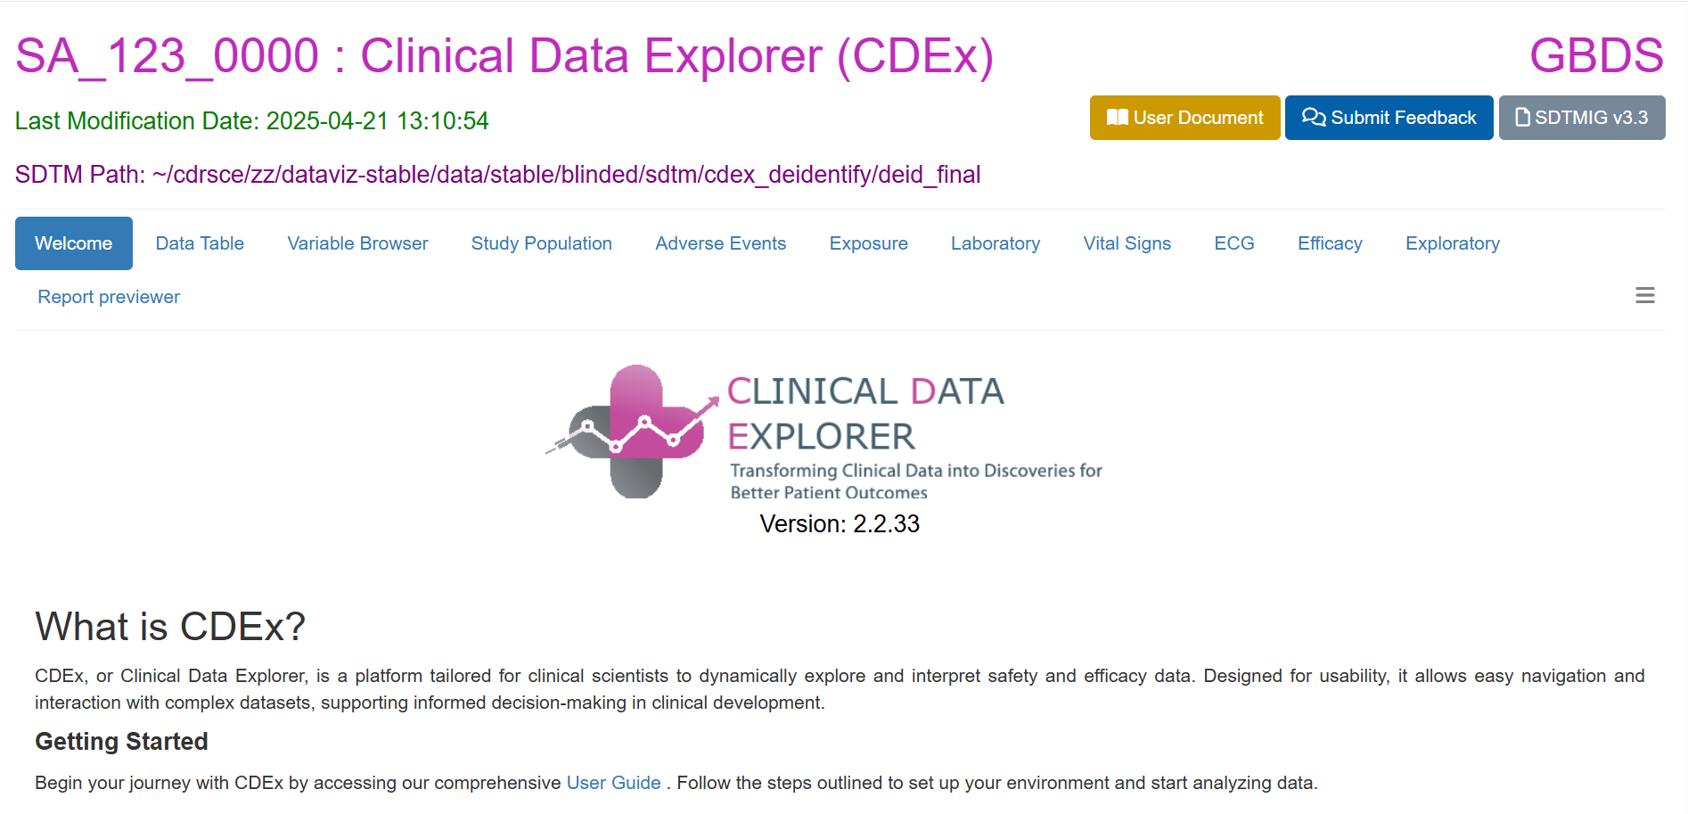

Slide 20
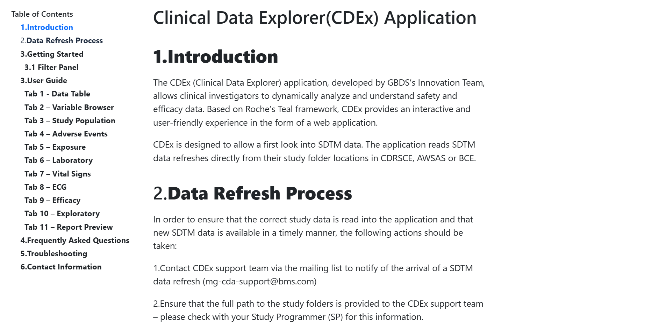

Slide 21
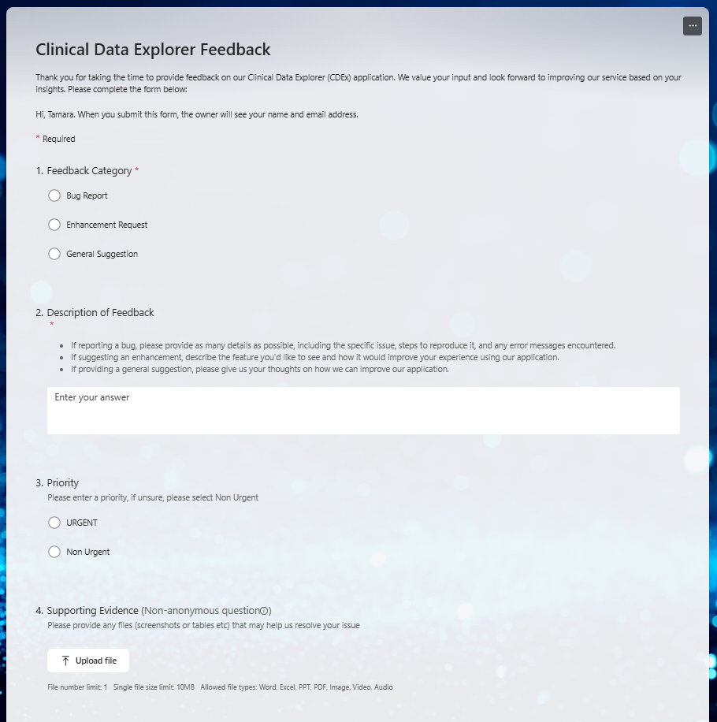

Slide 22
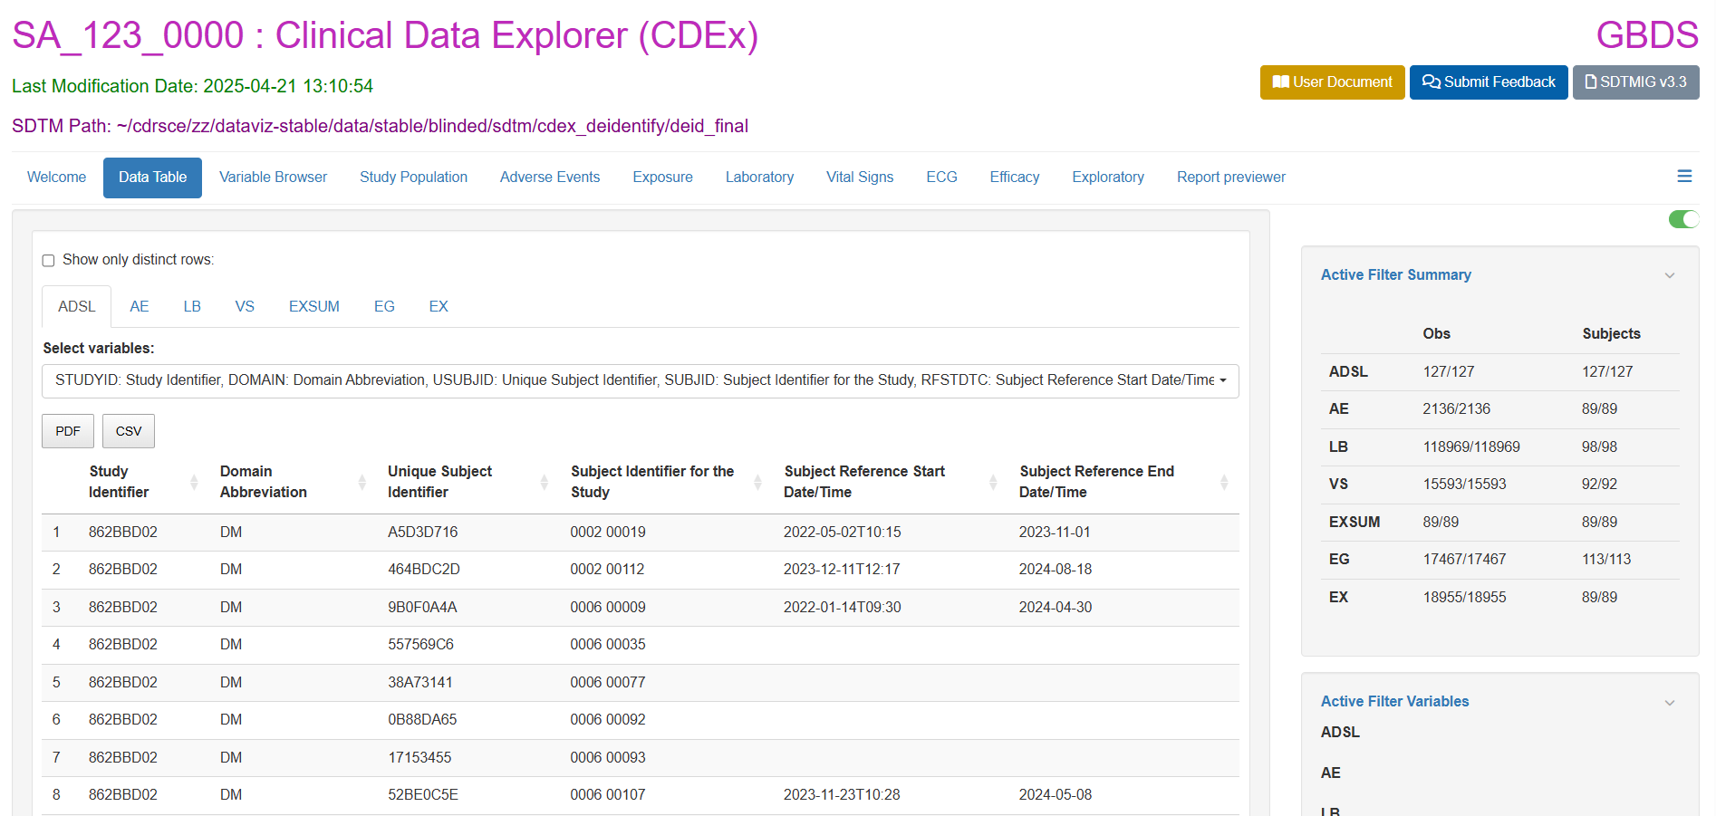
Notes:
Data Table
Allows users to review a listings of clinical data across different domains and organize the information for detailed analysis.

Slide 23
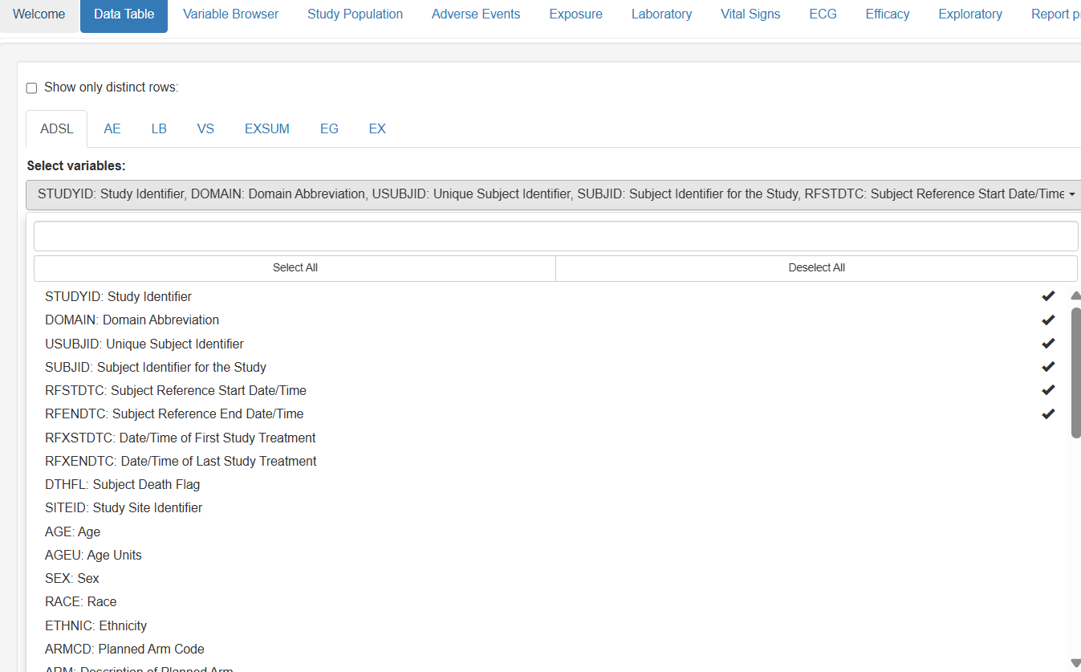
Notes:
Data Table
Allows users to review a listings of clinical data across different domains and organize the information for detailed analysis.

Slide 24
Notes:
Data Table
Allows users to review a listings of clinical data across different domains and organize the information for detailed analysis.

Slide 25
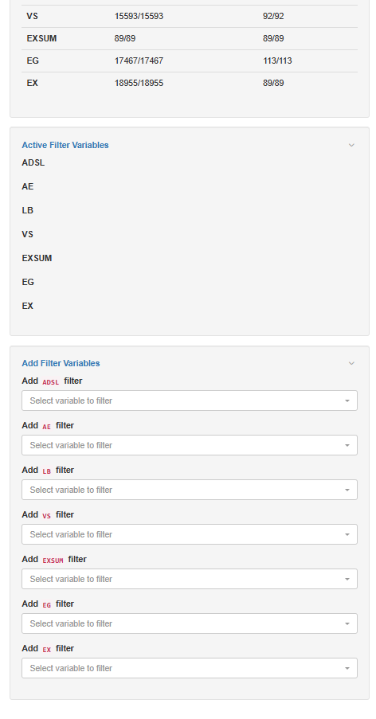
Global Filters
Notes:
Data Table
Allows users to review a listings of clinical data across different domains and organize the information for detailed analysis.

Slide 26
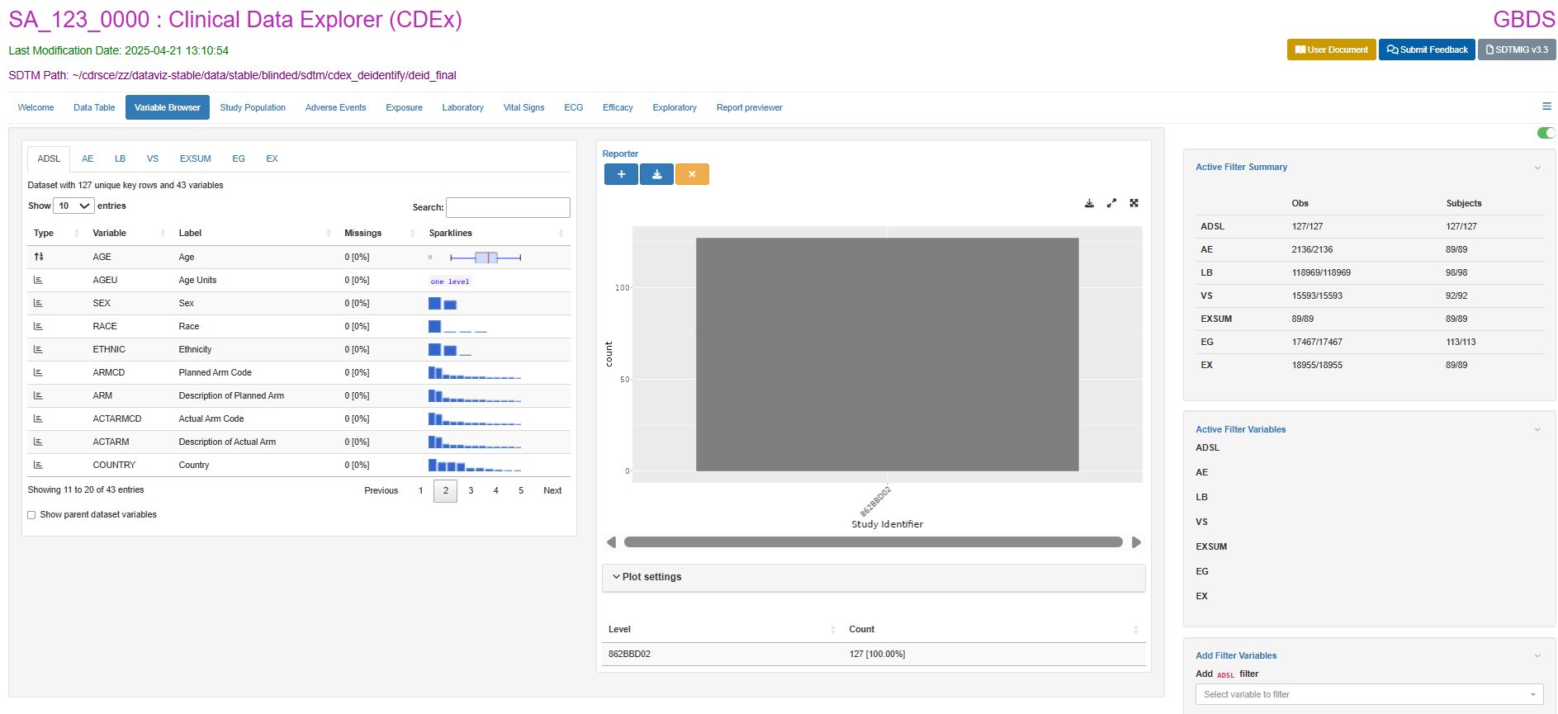
Notes:
Variable Browser
Offers univariate descriptive analysis for each variable within the domain datasets. This tab helps users visualize continuous variables through:
Horizontal Boxplots
Density Plots

Slide 27
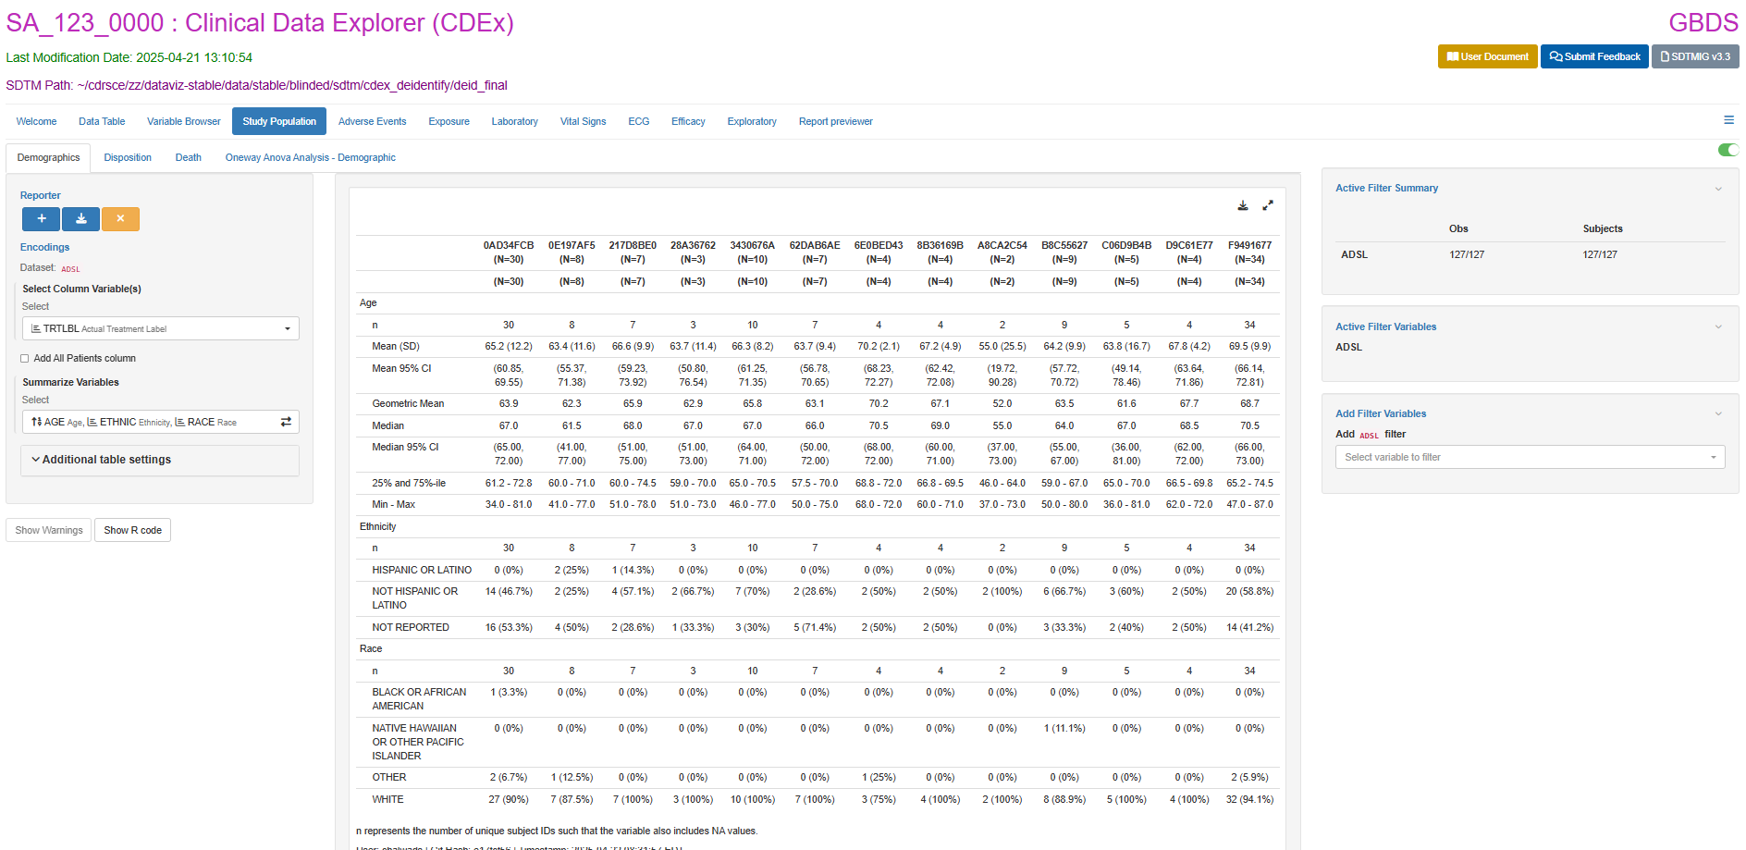
Notes:
Study Population
Provides a critical overview of patient characteristics and study populations.
Demographics: Offers detailed demographic statistics by treatments, country, regions, and etc.

Slide 28
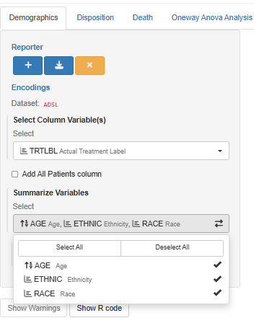
Notes:
Variable Browser
Offers univariate descriptive analysis for each variable within the domain datasets. This tab helps users visualize continuous variables through:
Horizontal Boxplots
Density Plots

Slide 29
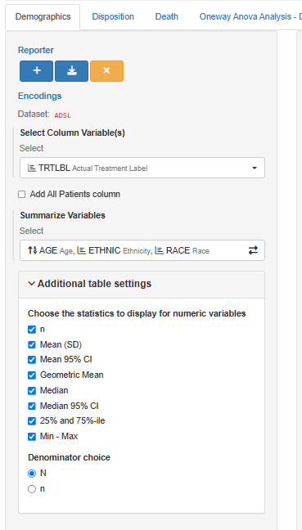
Notes:
Variable Browser
Offers univariate descriptive analysis for each variable within the domain datasets. This tab helps users visualize continuous variables through:
Horizontal Boxplots
Density Plots

Slide 30
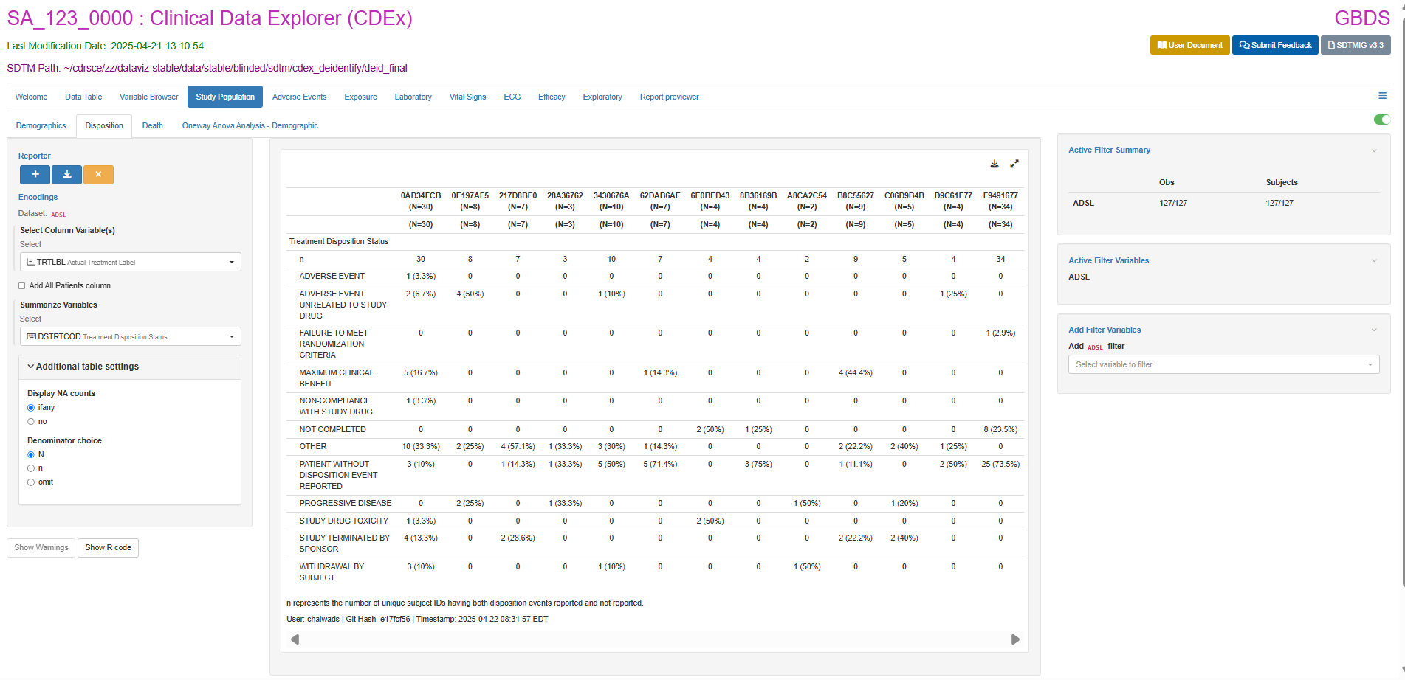
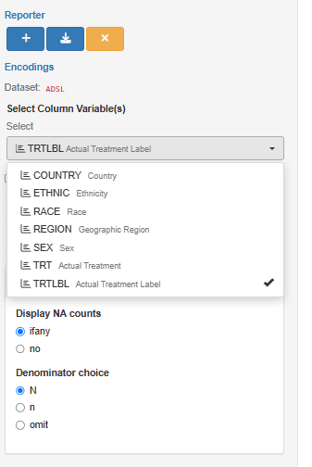
Notes:
Disposition Table: Displays a summary of the patient disposition (e.g., randomized, treated, discontinued).

Slide 31
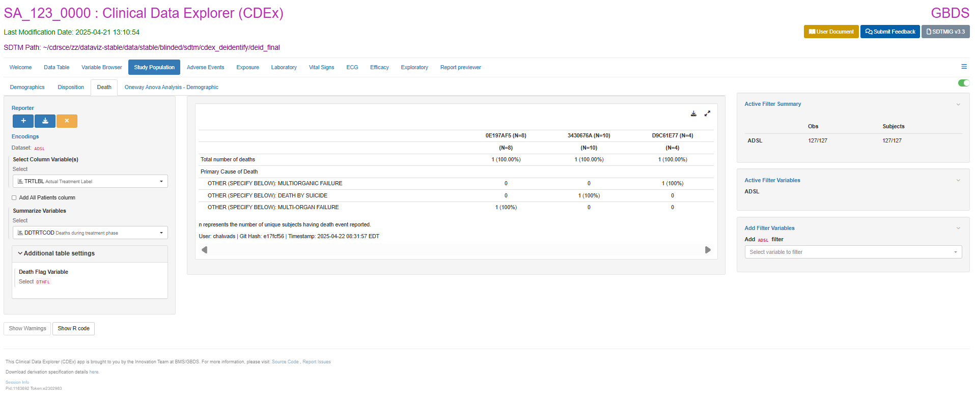
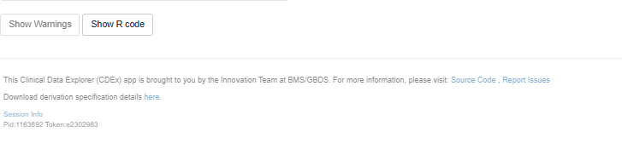
Notes:
Death Table: Displays a death summary of the patients.

Slide 32
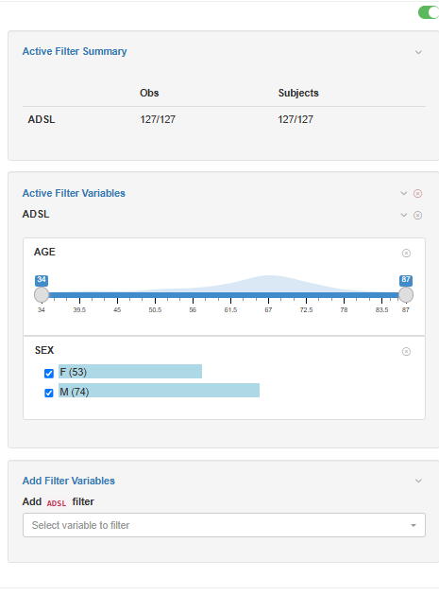
Notes:
Death Table: Displays a death summary of the patients.

Slide 33
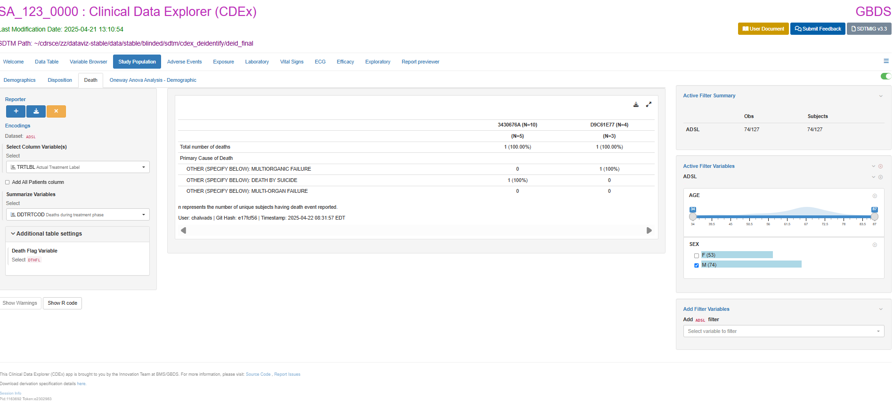
Notes:
Death Table: Displays a death summary of the patients.

Slide 34
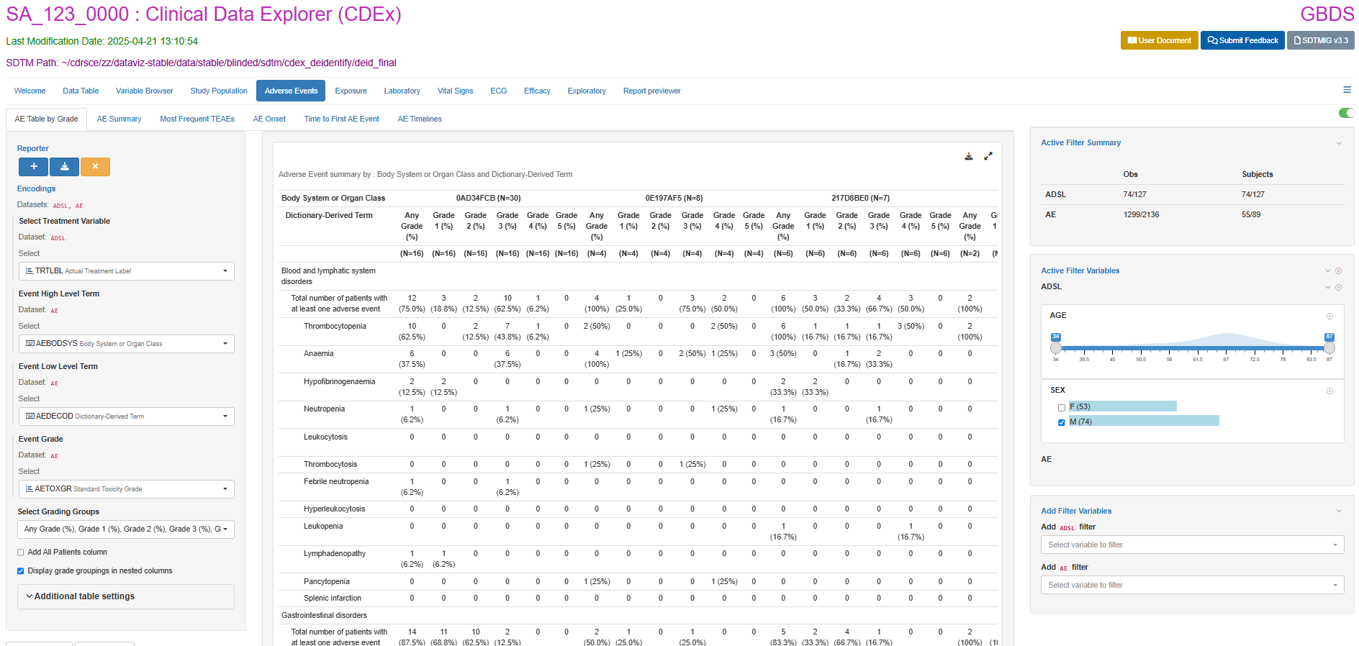

Slide 35
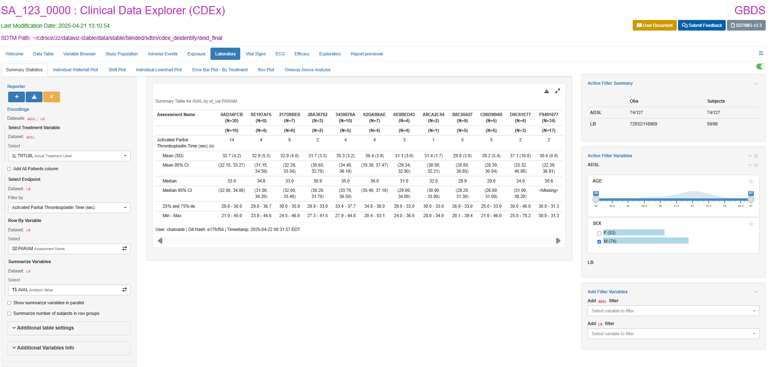

Slide 36
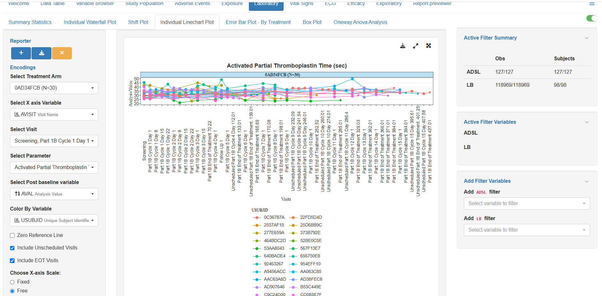
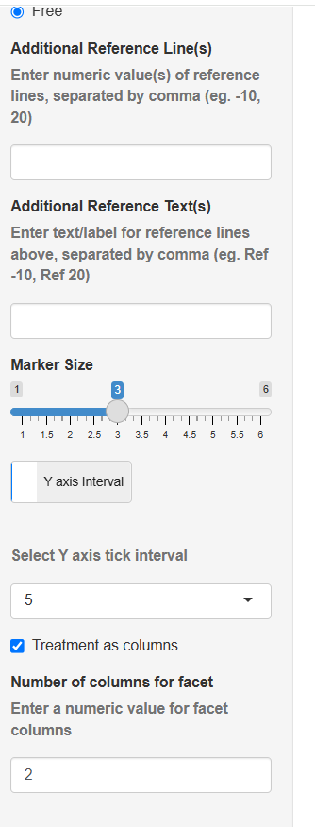
Notes:
Laboratory Data
CDEx also supports detailed visualizations of laboratory results, including:
Summary Statistics: Provides a summary table of laboratory data, allowing users to select treatment variables, endpoints, and summary variables for customized views.
Individual Waterfall Plot: Displays the mean or median values of laboratory parameters for individual patients across treatment arms, with customization options for post-baseline changes and specific patient selections.
Shift Plot: Compares changes in lab values between treatments from baseline to the end of the study, including options to show linear regression and scatter plots.
Individual Linechart Plot: Visualizes individual data points over time for different treatment arms, with customization options for facets and the number of columns.
Mean with Error Bars – By Treatment: Displays the average laboratory values for each treatment group, along with error bars to show variability.
Box Plot: Provides a visual summary of lab values across treatment groups by study visit.
Oneway Anova Analysis: Analyzes the differences between treatment groups using Oneway Anova plots, with customization options for data points and axis values.

Slide 37
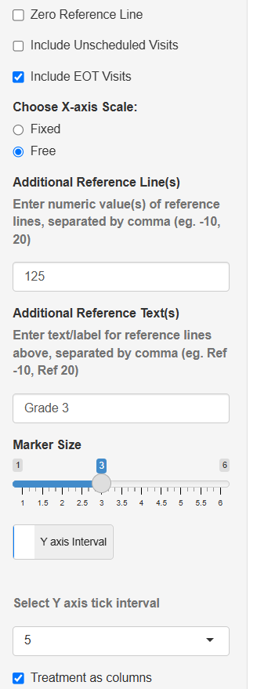
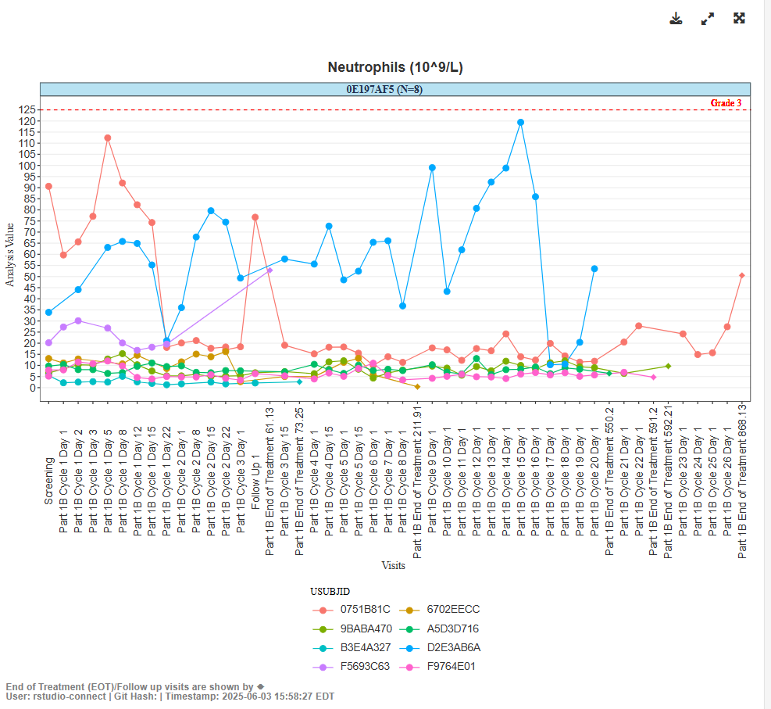
Notes:
Laboratory Data
CDEx also supports detailed visualizations of laboratory results, including:
Summary Statistics: Provides a summary table of laboratory data, allowing users to select treatment variables, endpoints, and summary variables for customized views.
Individual Waterfall Plot: Displays the mean or median values of laboratory parameters for individual patients across treatment arms, with customization options for post-baseline changes and specific patient selections.
Shift Plot: Compares changes in lab values between treatments from baseline to the end of the study, including options to show linear regression and scatter plots.
Individual Linechart Plot: Visualizes individual data points over time for different treatment arms, with customization options for facets and the number of columns.
Mean with Error Bars – By Treatment: Displays the average laboratory values for each treatment group, along with error bars to show variability.
Box Plot: Provides a visual summary of lab values across treatment groups by study visit.
Oneway Anova Analysis: Analyzes the differences between treatment groups using Oneway Anova plots, with customization options for data points and axis values.

Slide 38
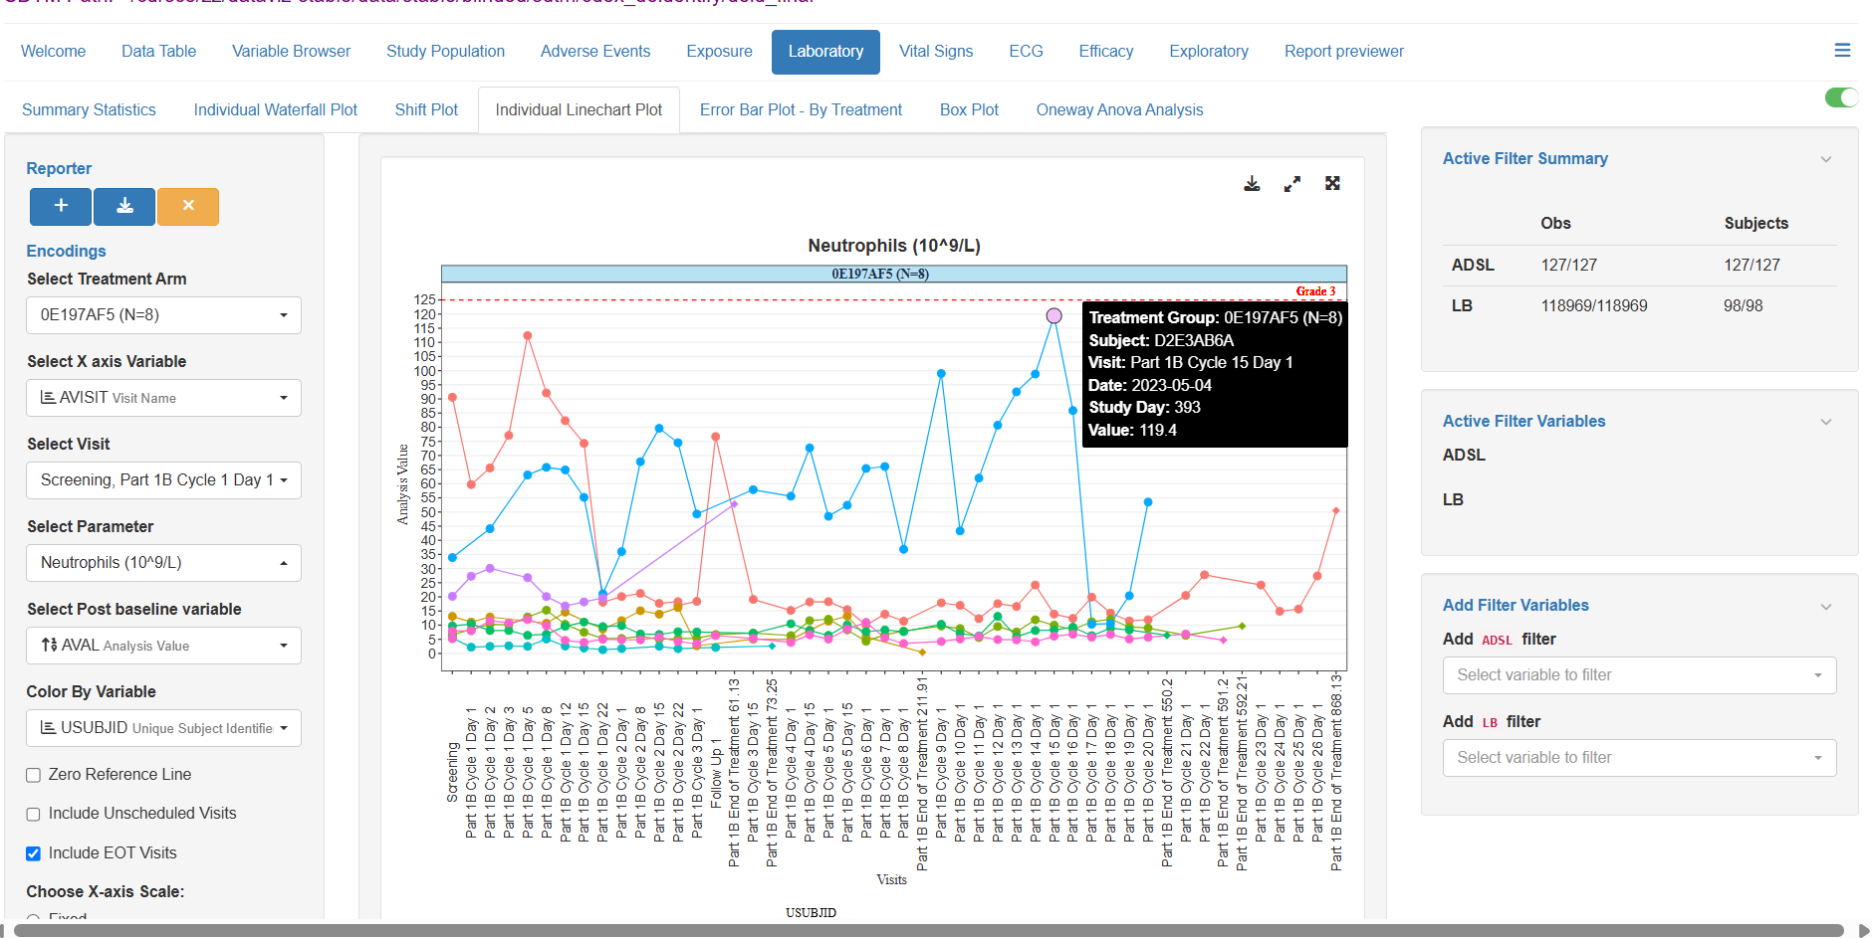
Notes:
Laboratory Data
CDEx also supports detailed visualizations of laboratory results, including:
Summary Statistics: Provides a summary table of laboratory data, allowing users to select treatment variables, endpoints, and summary variables for customized views.
Individual Waterfall Plot: Displays the mean or median values of laboratory parameters for individual patients across treatment arms, with customization options for post-baseline changes and specific patient selections.
Shift Plot: Compares changes in lab values between treatments from baseline to the end of the study, including options to show linear regression and scatter plots.
Individual Linechart Plot: Visualizes individual data points over time for different treatment arms, with customization options for facets and the number of columns.
Mean with Error Bars – By Treatment: Displays the average laboratory values for each treatment group, along with error bars to show variability.
Box Plot: Provides a visual summary of lab values across treatment groups by study visit.
Oneway Anova Analysis: Analyzes the differences between treatment groups using Oneway Anova plots, with customization options for data points and axis values.

Slide 39
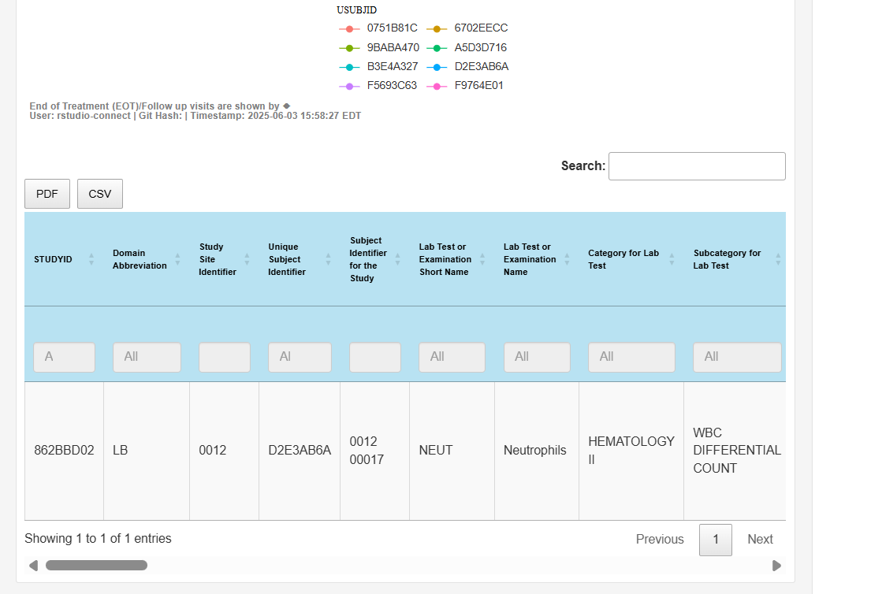
Notes:
Laboratory Data
CDEx also supports detailed visualizations of laboratory results, including:
Summary Statistics: Provides a summary table of laboratory data, allowing users to select treatment variables, endpoints, and summary variables for customized views.
Individual Waterfall Plot: Displays the mean or median values of laboratory parameters for individual patients across treatment arms, with customization options for post-baseline changes and specific patient selections.
Shift Plot: Compares changes in lab values between treatments from baseline to the end of the study, including options to show linear regression and scatter plots.
Individual Linechart Plot: Visualizes individual data points over time for different treatment arms, with customization options for facets and the number of columns.
Mean with Error Bars – By Treatment: Displays the average laboratory values for each treatment group, along with error bars to show variability.
Box Plot: Provides a visual summary of lab values across treatment groups by study visit.
Oneway Anova Analysis: Analyzes the differences between treatment groups using Oneway Anova plots, with customization options for data points and axis values.

Slide 40
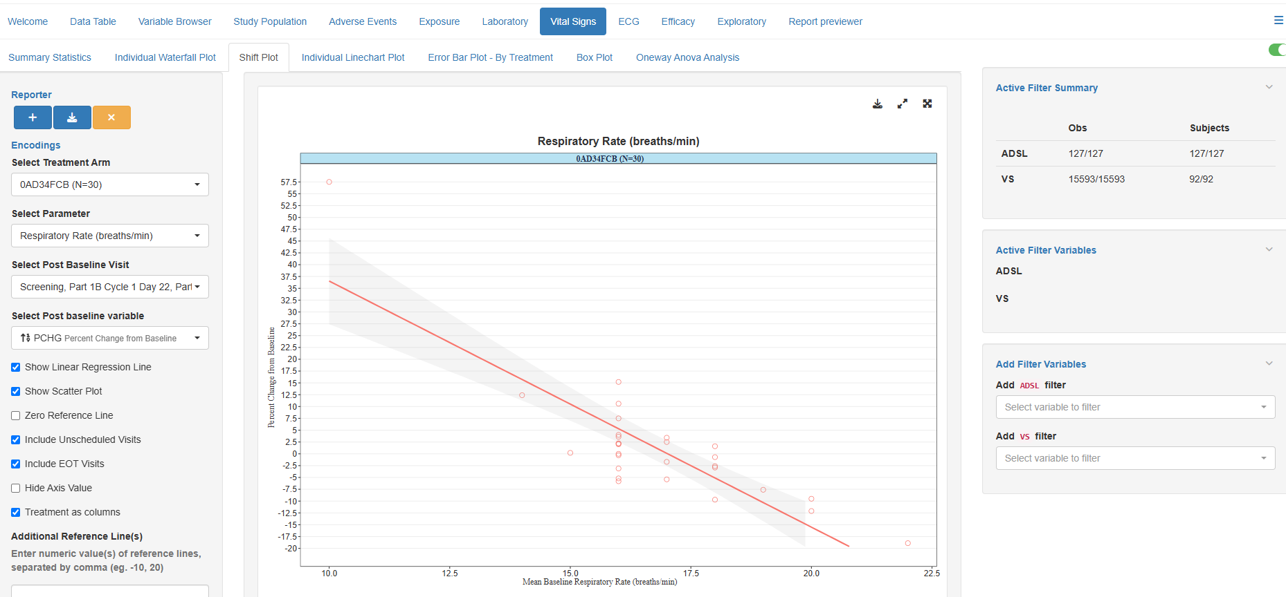

Slide 41
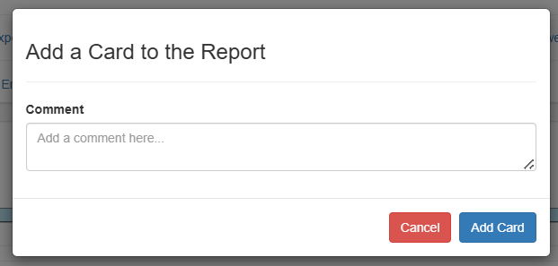

Slide 42
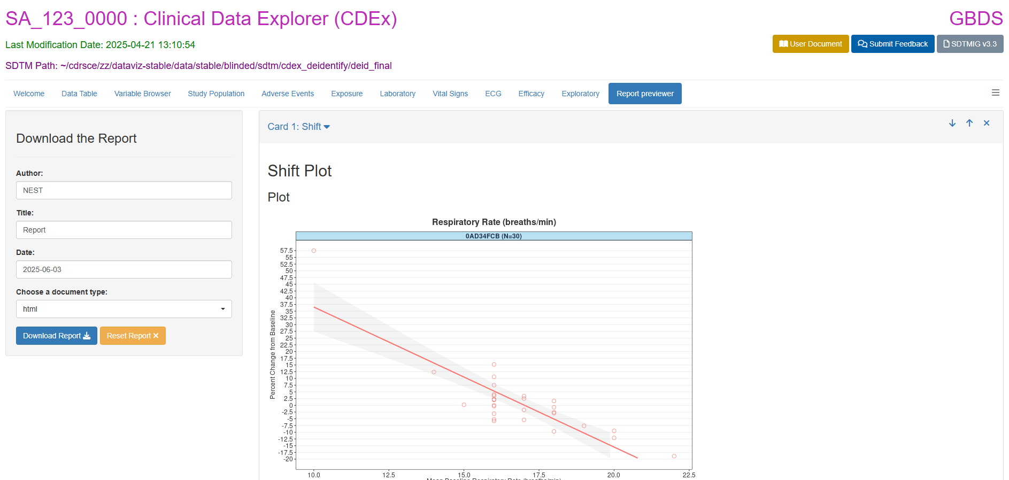

Slide 43
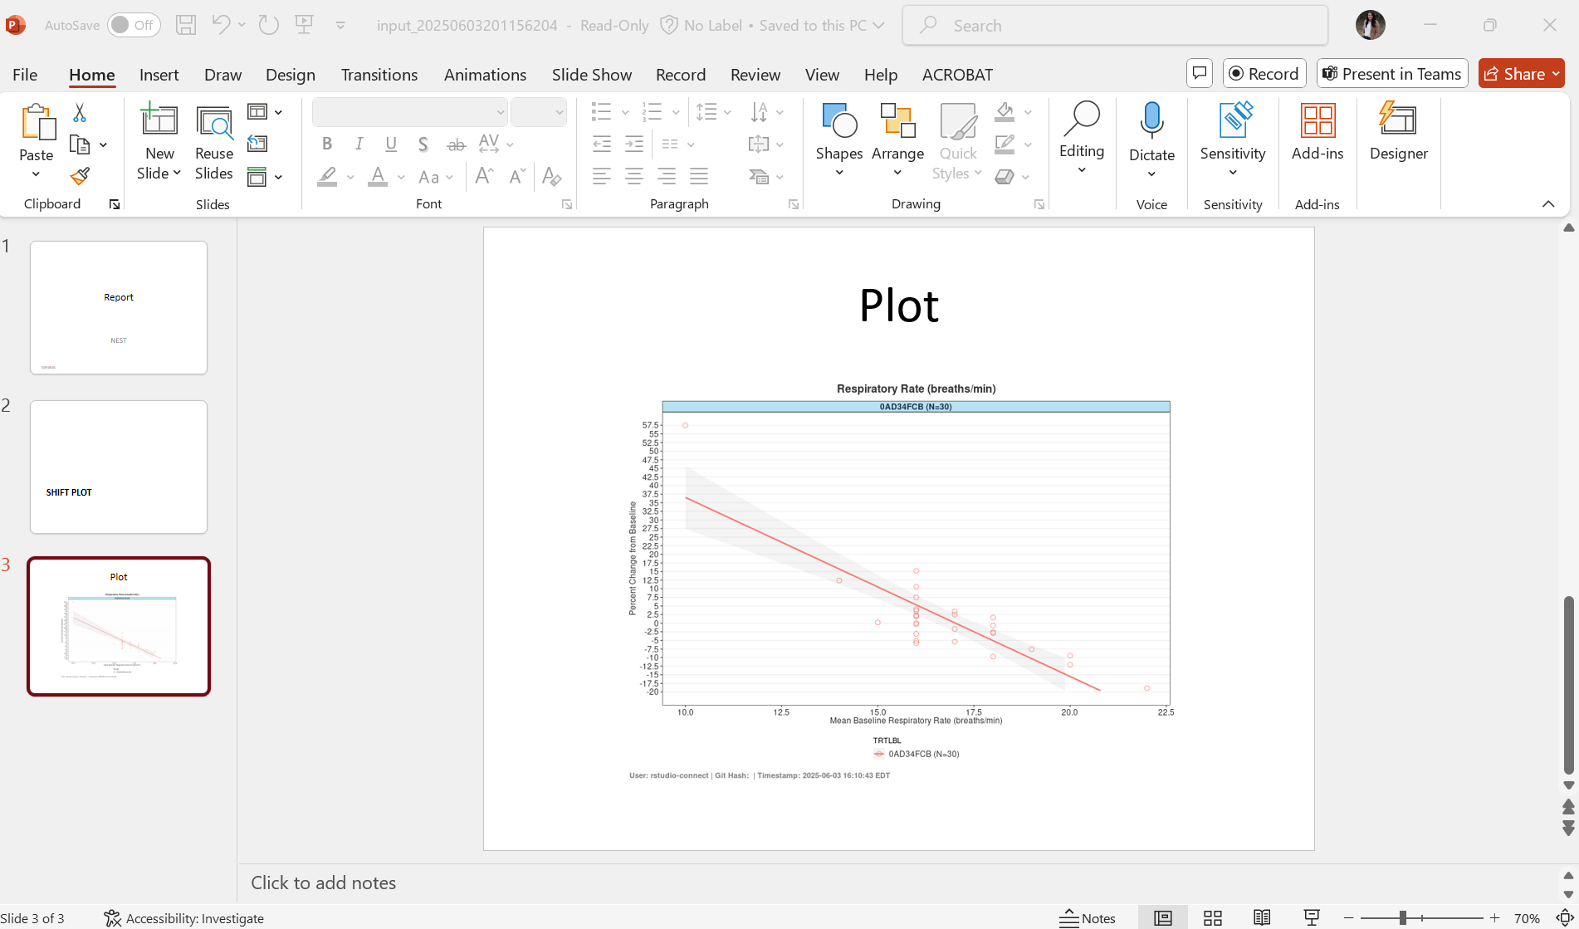

Slide 45


Executive Sponsor - Standards and Innovation
Nicole Thorne
Thank You.
CDEx Developers:
Manish Bhagchandani
Shekhar Chalwadi
Nandukrishnan H
Hitesh Juneja
Maheshwarn Muthiah
Akshata Salian
Dineshkumar Subbu
Core CDEx SME Team (Non-Authored):
Silvia Mosulen Machuca
Mohan Mandava – Executive Sponsor LD HOCT
Yun Shen
Sandra Kreitz
Early Development Build Team:
Sadhna Mishra
Akshay Nethikar
Bharath Pakeer
Additional Contributor:
John Gerks
Teamwork That Transforms
Because our Innovation Strategy is only as strong as the people behind it.

Slide 46





Clinical Data Explorer (CDEx) Technical Lead
Karma Tarap
Karma.Tarap@bms.com
Thank You.
Executive Sponsor - Clinical Data Explorer (CDEx) CS Lead
Oriana Esposito
Teamwork That Transforms
Clinical Data Explorer (CDEx) Technical Lead
Maheshkumar Umbarkar
Masheshkumar.Umbarkar@bms.com
Because our Innovation Strategy is only as strong as the people behind it.
Clinical Data Explorer (CDEx) Programmer
Ramnath Balasaheb Dhadage
Clinical Data Explorer Core Team Lead
Tamara Martin
Tamara.Martin@bms.com

